Slide 1
The Cytoskeleton & cell cycle
Dr Hemed El-busaidy

Slide 2
The cytoskeleton
Microtubules
Microfilaments
Intermediate filaments
Functions:
Responsible for cell locomotion
Structural framework
Stability
Cell shape/morphology
Cell division

Slide 3
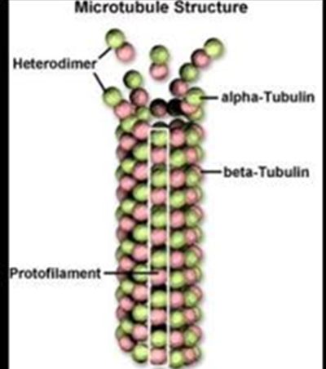
MICROTUBULES
Main molecular motors of the cell
Made of protein subunits α &β tubulins.
Aggregate to form stack rings.
assembly & disassembly brings movement
They Provide tracks along which different molecular proteins transport organelles and vesicles in the cytoplasm
2 proteins are responsible for movement:
Dyneins: transport towards the centre
Kinesin: transport towards periphery

Slide 4
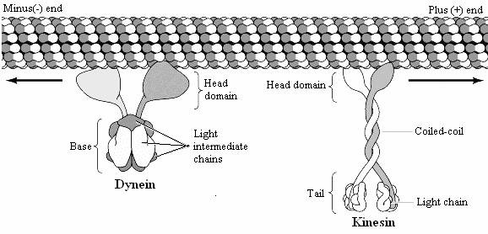
Dynein & kinesin

Slide 5
Video of kinesin

Slide 6
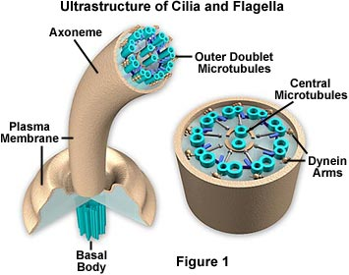
Distribution of microtubules
Cilia
Flagella
Centrioles during cell division

Slide 7
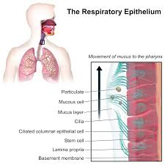
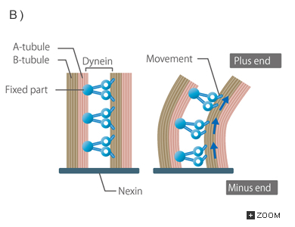
Ciliary movement
Outcropping of cell membrane supported by microtubules linked together by axoneme.
Motion is achieved by interaction of microtubules
with dyneins

Slide 8
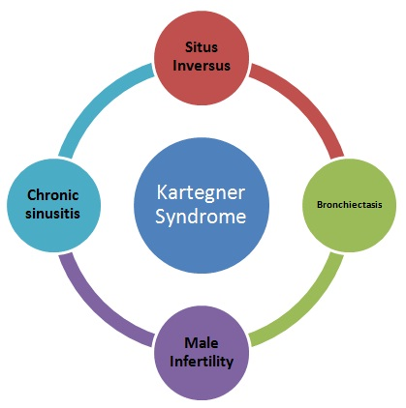
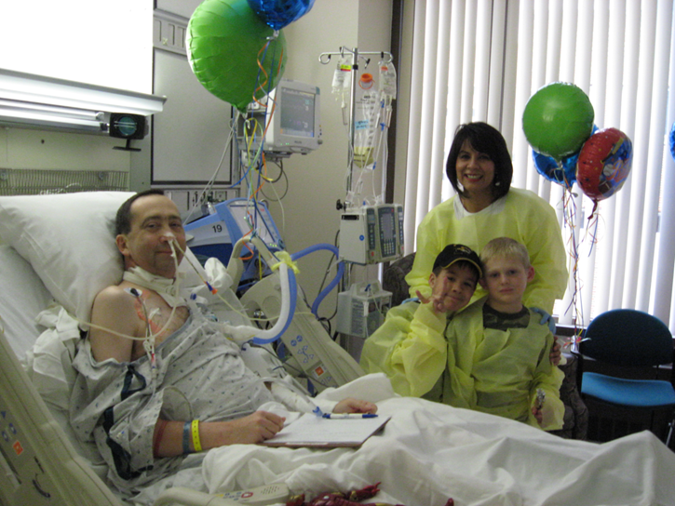
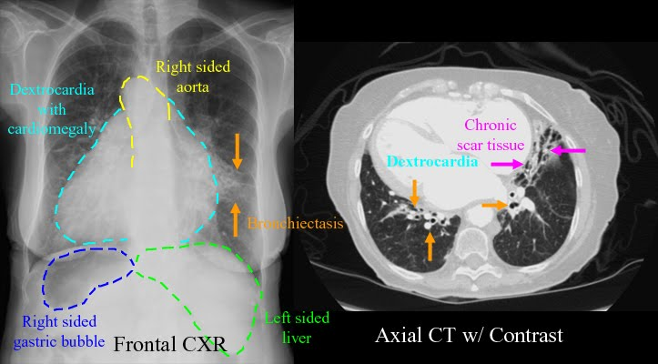

Slide 9
Clinical significance
Several drugs disrupt cellular function by interaction with microtubules
Colchicine and vinblastine prevent microtubule assembly in cancer cells
Paclitaxel binds to microtubules making them stable thus preventing movement of cancer cells.

Slide 10
(B) Intermediate filaments(10nm)
function: Cell scaffolding (support/binding), helps the cell to resist external pressure.
Formed from cell-type specific proteins, thus may be used as cell markers eg
vimentin→mesodermal in origin
Cytokeratin→epithelial cells
Desmin- muscle
Neurofilaments→neurons
Important in immunopathology

Slide 11
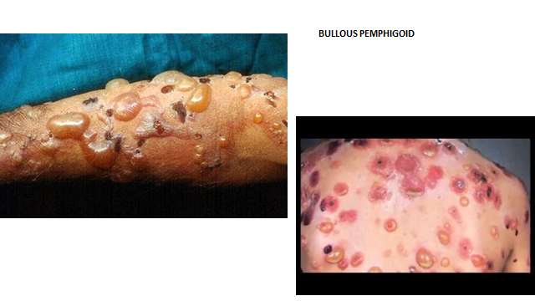
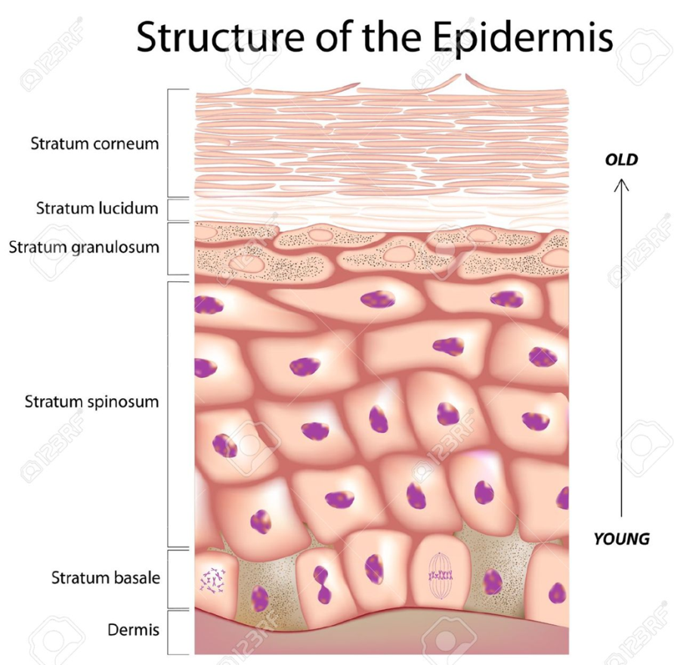
Problems of cytokeratin
Notes:
Bullous Pemphigoid is the result of an attack on the basement membrane of the epidermis by IgG +/- IgE immunoglobulins (antibodies) and activated T lymphocytes .
They are associated with the hemidesmosomes, structures that ensure the epidermal keratinocyte cells stick to the dermis to make a waterproof seal.

Slide 12
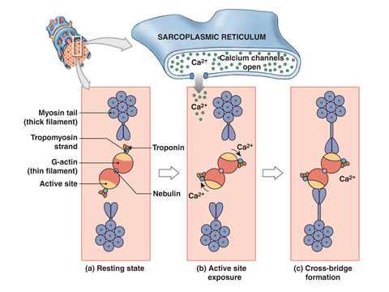
Interaction of actin & myosin
Microfilaments eg actin

Slide 13
The cell cycle
Has 2 phases:
Interphase
mitosis

Slide 14
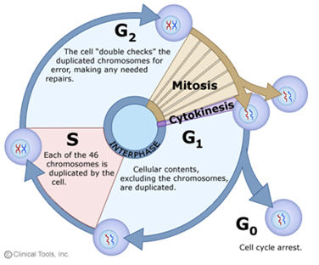
INTERPHASE (G1-G2)

Slide 15
mitosis
Prophase: condensation of chromosomes.
Kinetochores from mitotic spindle attach to chromatids(prometaphase)
Metaphase: alignment of chromatids at the centre
Anaphase: splitting of centromere and separation of sister chromatids
Telophase: uncoiling of chromosomes
Cytokinesis: plasma membrane division mediated by actin and myosin

Slide 16
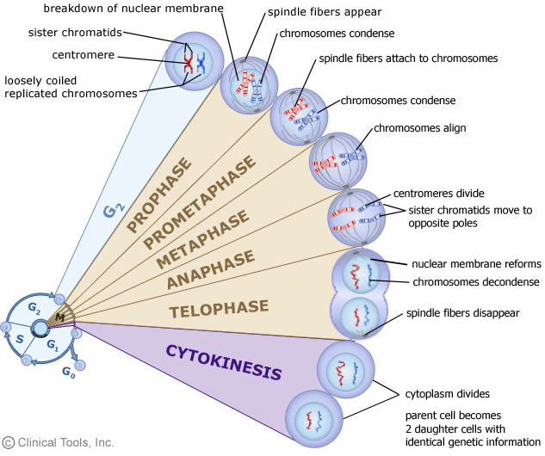
mitosis

Slide 17
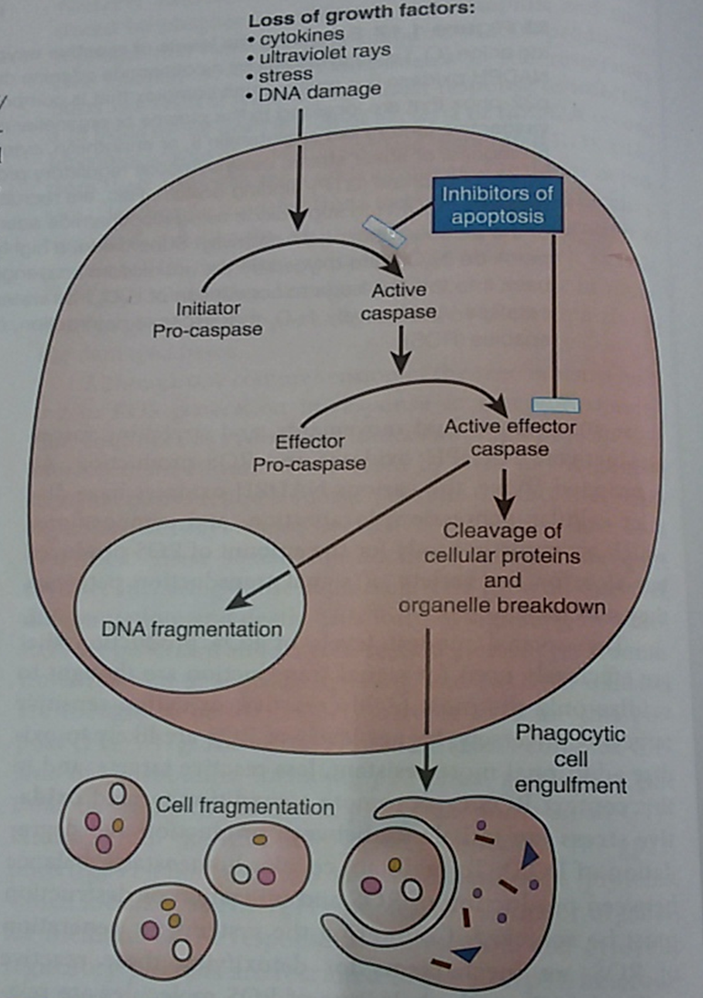
apoptosis
Programmed cell death

Slide 18
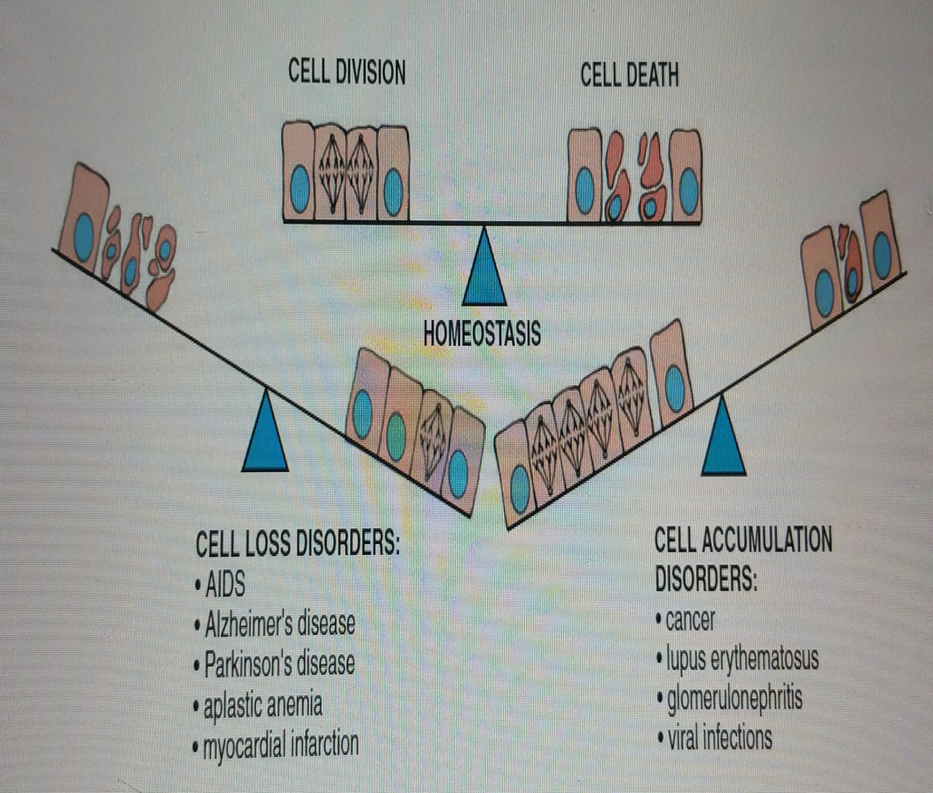
Apoptosis is a balanced process

Slide 19
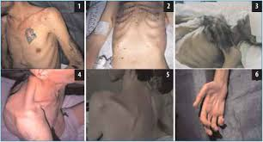

Slide 20
The end

